Slide 1
Designing.
Simon Wilson
Interaction designer, DWP Digital
Notes:
Hello. I’m Si. I’m an interaction designer, working out of Leeds. I’ve been here for six months. Before that I was a design lead on the NHS Beta programme, a design lead at HMRC, and before that I’ve run and lead digital companies and design studios.

Slide 2
What is design?
Notes:
It feels like a good time to have a little reflection on what design is.
We’ve had a lot of new designers asking what is the design process?
I’ve heard staff saying what do designers do? What does design do?
Designers then need something to help them back up what they are doing.
So, let’s start getting just enough down.

Slide 3
“Design is how it looks.”

Slide 4
“Design is how it looks.”
Notes:
First, designing is imagining a future and working toward it with intelligence and cleverness. We use design to close the gap between the situation we have and the one we desire.
Second, design is a practice built upon making things for other people - and what they need.

Slide 5
Design
is how something will work / should work.
Designing
is working out how something will work / should work.

Slide 6
Good design is usefulness.
Notes:
Everything you see around you, every moment of every day, is designed.

Slide 7
Deliberate
High
Intention
Accidental
Low
Chance of success
Notes:
If we were to look at a design and its outcomes we assess it using a chart like this. (other charts are available)
Some is good, some is bad. Some is intentional. Some is possibly not so intentional. Sometimes it’s intentional that something is badly designed.
Usefulness would sit in the trop half of this chart.

Slide 8
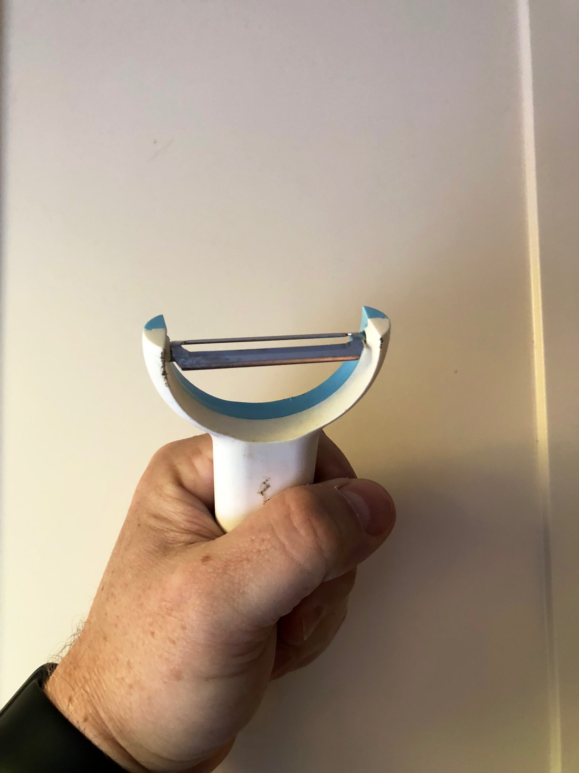
Notes:
Here’s one of my favourite bits of design.
It’s a potato peeler.
You can probably work through some user needs in your head.
“As someone cooking dinner I need to make chips - mainly because I have an abundance of potatoes in the fridge. My wife and kids are put off potato things that have the skin on. Jacket potatoes. Chips with the skin on. But they really like chips - so my family receive some nutritional food - which is usually the stuff all around teh chips.”
It basically a fancy blade, but some thinking means it’s easier for to hold and cut away the skin on a potato than a standard knife. This lessens my chances of cutting myself and lessons the amount of wasted potato. Another thing: These are quite cheap to make and that makes that more accessible to potential users

Slide 9
Design is mindful.
Notes:
The best design is loosely composed, responsive, - responding to context

Slide 10
User centred design.
Notes:
So, at DWP, in gov, in other organisation and business around the world we try to employ user centred design.
“Duh,” a friend of mine said several years back. “User centred design. Human centred design. It’s not like there’s, say, badger centred design.”
The point is creating things that are usable, with the focus on the the person’s existing habits.
A thing often missed in doing user centred design is it is about trying ** to avoid ** changing people’s habits. We find out what fits in with their ways of doing stuff.

Slide 11
User centred people.
User centred teams.
User centred organisation.

Slide 12
A designer
The rest of the team

Slide 13
The design team
The delivery team

Slide 14
A team of user centred people

Slide 15
Sharing
Cooperation
Collaboration
Collectivism
Notes:
Clay Shirky’s Here Comes Everybody - digital socialism

Slide 16
The black box of dev
Design
Live
Notes:
So why am I here?
Six months in it sometimes feels we are still “design happens”, and then it goes into the black box of dev packaged up, and it’s live.
We put a lot of onus on the process of developing.
We can easily miss the nuance of design as a process. Design is a process.

Slide 17
“They slow us down to speed us up. By taking the time to discover, to understand, we avoid costly mistakes such as becoming too complex too early and sticking with a weak idea for too long.”
–Tim Brown, IDEO

Slide 18
Ego-less design.

Slide 19
Discovery
Alpha
Beta
Live
Notes:
In our world that could translate to the “discovery” phase. We’ll come back to that.

Slide 20
We are always discovering.

Slide 21
Understand the problem space.

Slide 22
Stakeholders
Delivery
Minister(s)
Product owner
Users
Subject matter expert (SME)
Delivery manager
Policy team
User researcher
Government Digital Service
Developers / engineers
Content designer
Operations
Interaction designer
Testers
Service designer
Technical architects
Business analyst
Notes:
Here’s a something to represent some, most of the roles on a service or on product. There’s a few missing, but you get the idea.
You probably recognise a lot of these roles. Business analysts: thought of them as business researchers, half to help us understand what the business needs now, but also be problem solvers to help us understand how the ;possibly of a useful design. They are useful allies negotiating the existing frameworks of an organisation.
That intersection to me is the the problem space problem space.
And the keys role in this is that of the product owner. Everyone under the product owner presents information to the product owner, analysis even, and it is the product owner’s call what to do.

Slide 23
Understanding
Define
Ideate
Prototype
Test
Production
Do research to discover who users are what they do, say, think and feel.
Combine research and analyse to understand users and their needs.
Focused on the needs, as a team explore possible ideas. Quantity over quality.
Build tactile representations of your ideas. Consider impact versus feasibility.
Put the work in front of users. Find what works and doesn’t work.
Notes:
This is a cycle, not a flow. We can go back at any point. And when it’s good enough - the product owner’s call - it moves onto production.

Slide 24
Discovery
Alpha
Beta
Understanding
Define
Ideate
Prototype
Test
Production
Do research to discover who users are what they do, say, think and feel.
Combine research and analyse to understand users and their needs.
Focused on the needs, as a team explore possible ideas. Quantity over quality.
Build tactile representations of your ideas. Consider impact versus feasibility.
Put the work in front of users. Find what works and doesn’t work.
Notes:
People sometimes see the discovery / alpha / beta / live as a flow too. They’re sort of right. But if we overlay under that a cycle for designing, the cycle for designing - or bits of it - sit into the phases of product making.

Slide 25
Designing
Developing
Notes:
So there’s two almost comparable cycles there.

Slide 26
Continual gradual improvement
Notes:
This isn’t a call to arms to land the big ship. We should be mindful of this, aiming for this. Regularly making things better, but mindful of risk.

Slide 27
What’s the worst that could happen?
Notes:
A good place to start. Know what bad is. Know what unacceptable is. Know the risks. The things we are doing effect people lives.

Slide 28
Find what works –
and what doesn’t work.
Notes:
Then.

Slide 29
Finding what works needs understanding.
Notes:
Impatience
Urge to get it out there
It’s easy to slip into a mode where you Move fast and breaks things.

Slide 30
Frameworks.
Notes:
In government we often talk about the frameworks. Being agile. The service standard. Design patterns. These are all things to help us not to get from A to Z in one step, but to nudge us from A to B, to C, to D.
Existing systems and processes could also be viewed as frameworks. It’s hard to let go of these as well. What in there helps us avoid risk - especially as over time they’ve been built to avoid all risk.
Limitations narrow a big process into a smaller, understandable space to explore.
Embrace usefulness as a framework.

Slide 31
Just.
enough.
process.

Slide 32
Context.
Context.
Context.
Notes:
We must always be designing and mindful of context.
Patterns are a good example of this. Seen as a short cut to a solution, not a path to reaching an outcome.

Slide 33
Agreement.

Slide 34
The goal
Services and products that are designed using knowledge over assumptions.

Slide 35
“A prototype is an early sample, model, or release of a product built to test a concept or process or to act as a thing to be replicated or learned from.”

Slide 36
“A prototype is an early sample, model, or release of a product built to test a concept or process or to act as a thing to be replicated or learned from.”

Slide 37
“A prototype is a model to test a concept or process as a thing to be learned from.”

Slide 38
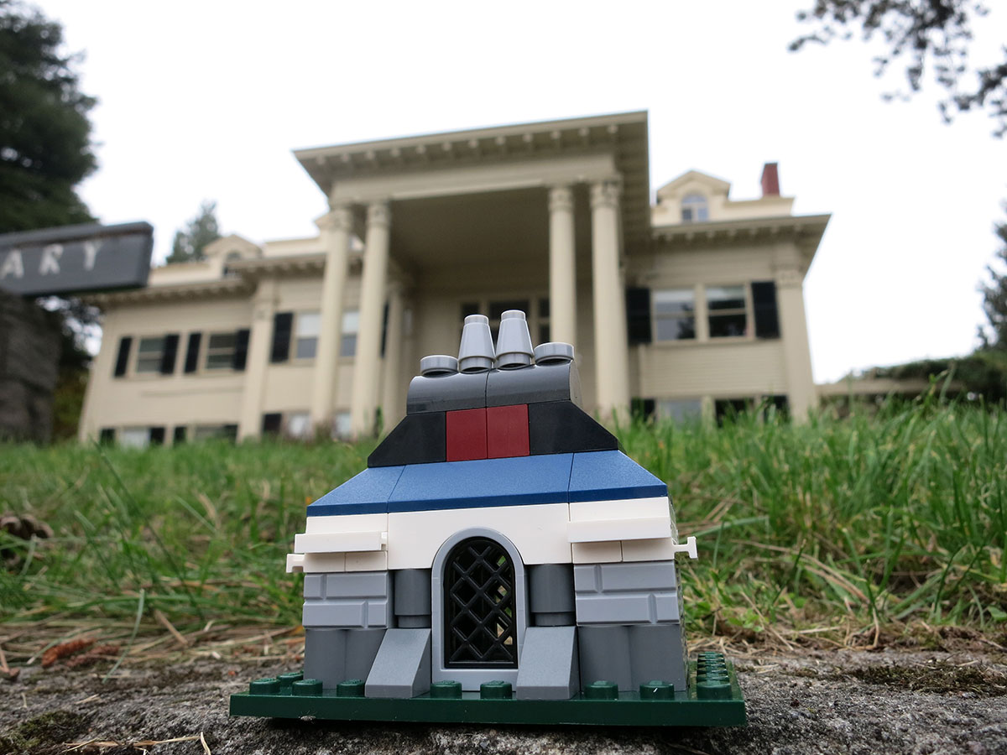

Slide 39
A prototype allows you to
explore an idea, a thought, a theory, an approach

Slide 40
Prototypes are cheap, quick.

Slide 41
Prototype
Prototypes are disposable.
Notes:
The thing we keep is a learning.

Slide 42
There is no one way to create a prototype.
Notes:
There is no one “The prototype”. There are prototypes.

Slide 43
43 types of prototype
Notes:
Earlier this year in a user centred design community meet I got those assembled to take a few minutes to scribble onto stickies types of prototype they’d done. We got something like 73 stickies which when synthesised down gave us 43 types of prototype.

Slide 44
IA work: Card sorting (physical or digital)
User journeys (2)
Service maps (2)
Role playing
Service prototyping and pop-ups
Wizard of Oz
Whiteboarding
Card and Post It service mock-up
Post Its for content architecture
Paper and Post Its for content design
Post Its (2)
Sketches (4) (including “pen and paper”)
Paper sketching
Paper UI sketch flow
Google Draw document
Wireframes
Wireframe user journey
Interactive wireframe (Balsamiq etc)
Axure (2)
Spreadsheets (2)
Do content in Google Docs or Word
Do “screens/pages” in Google Docs and click through
Clickable prototype using sketches/screen grabs in Marvel app
In-Vision
Screen designs in Powerpoint (2)
Presentations in Powerpoint (3)
Show page flow in Powerpoint
Design in Keynote (1)
Presentations in Keynote (2)
Sketch (app) (4)
Screenshots showing sequence, user flow, changed copy, overload text, etc / printed stages in a flow stuck on a table
Letters Posters
Call scripts
Storyboards
Videos
Chatbot
In-browser editing page’s code and screen grabbing (5)
Other HTML mock-ups
gov.uk prototype kit (10)
• static
• “almost like the real thing”
Verify prototype kit
B variants
AB testing
Doing changes to/off a “built service” (2)
Notes:
Here’s that list.

Slide 45
Ask yourself every time
What is the purpose of the prototype you need?
Notes:
This is where the relationship between the product owner and the rest of the problem space team comes in.
What is the problem in front of us? As a product owner what is the thing we need to learn of the greatest value at this moment?

Slide 46
sprint planning
backlog planning (and scoring if its development work)
design
creating a prototype
organising user research
research days
analysis
playback
iterating
development
http://www.gavinelliott.co.uk/2017/11/good-product-development-process/
Notes:
Agile isn’t about making it up every day as you go along. There is some order to the chaos. In scrum we operate in sprints. We review after every sprint. This allows us to tentatively plan, pencil sketch was we are doing.
There is so much time. Here’s a product development wheel taken from post of Gav’s: http://www.gavinelliott.co.uk/2017/11/good-product-development-process/
How do you fit your discovering into that? There is only so much time

Slide 47
Lots
High
Time
Little
Low
Fidelity
Notes:
And that has an effect on what we can do.

Slide 48
Low fidelity
Rough
Quick
Low cost

Slide 49
High fidelity
Detail
Need time
Higher cost

Slide 50
Fidelity is as much about your thinking as it about what something looks like.

Slide 51
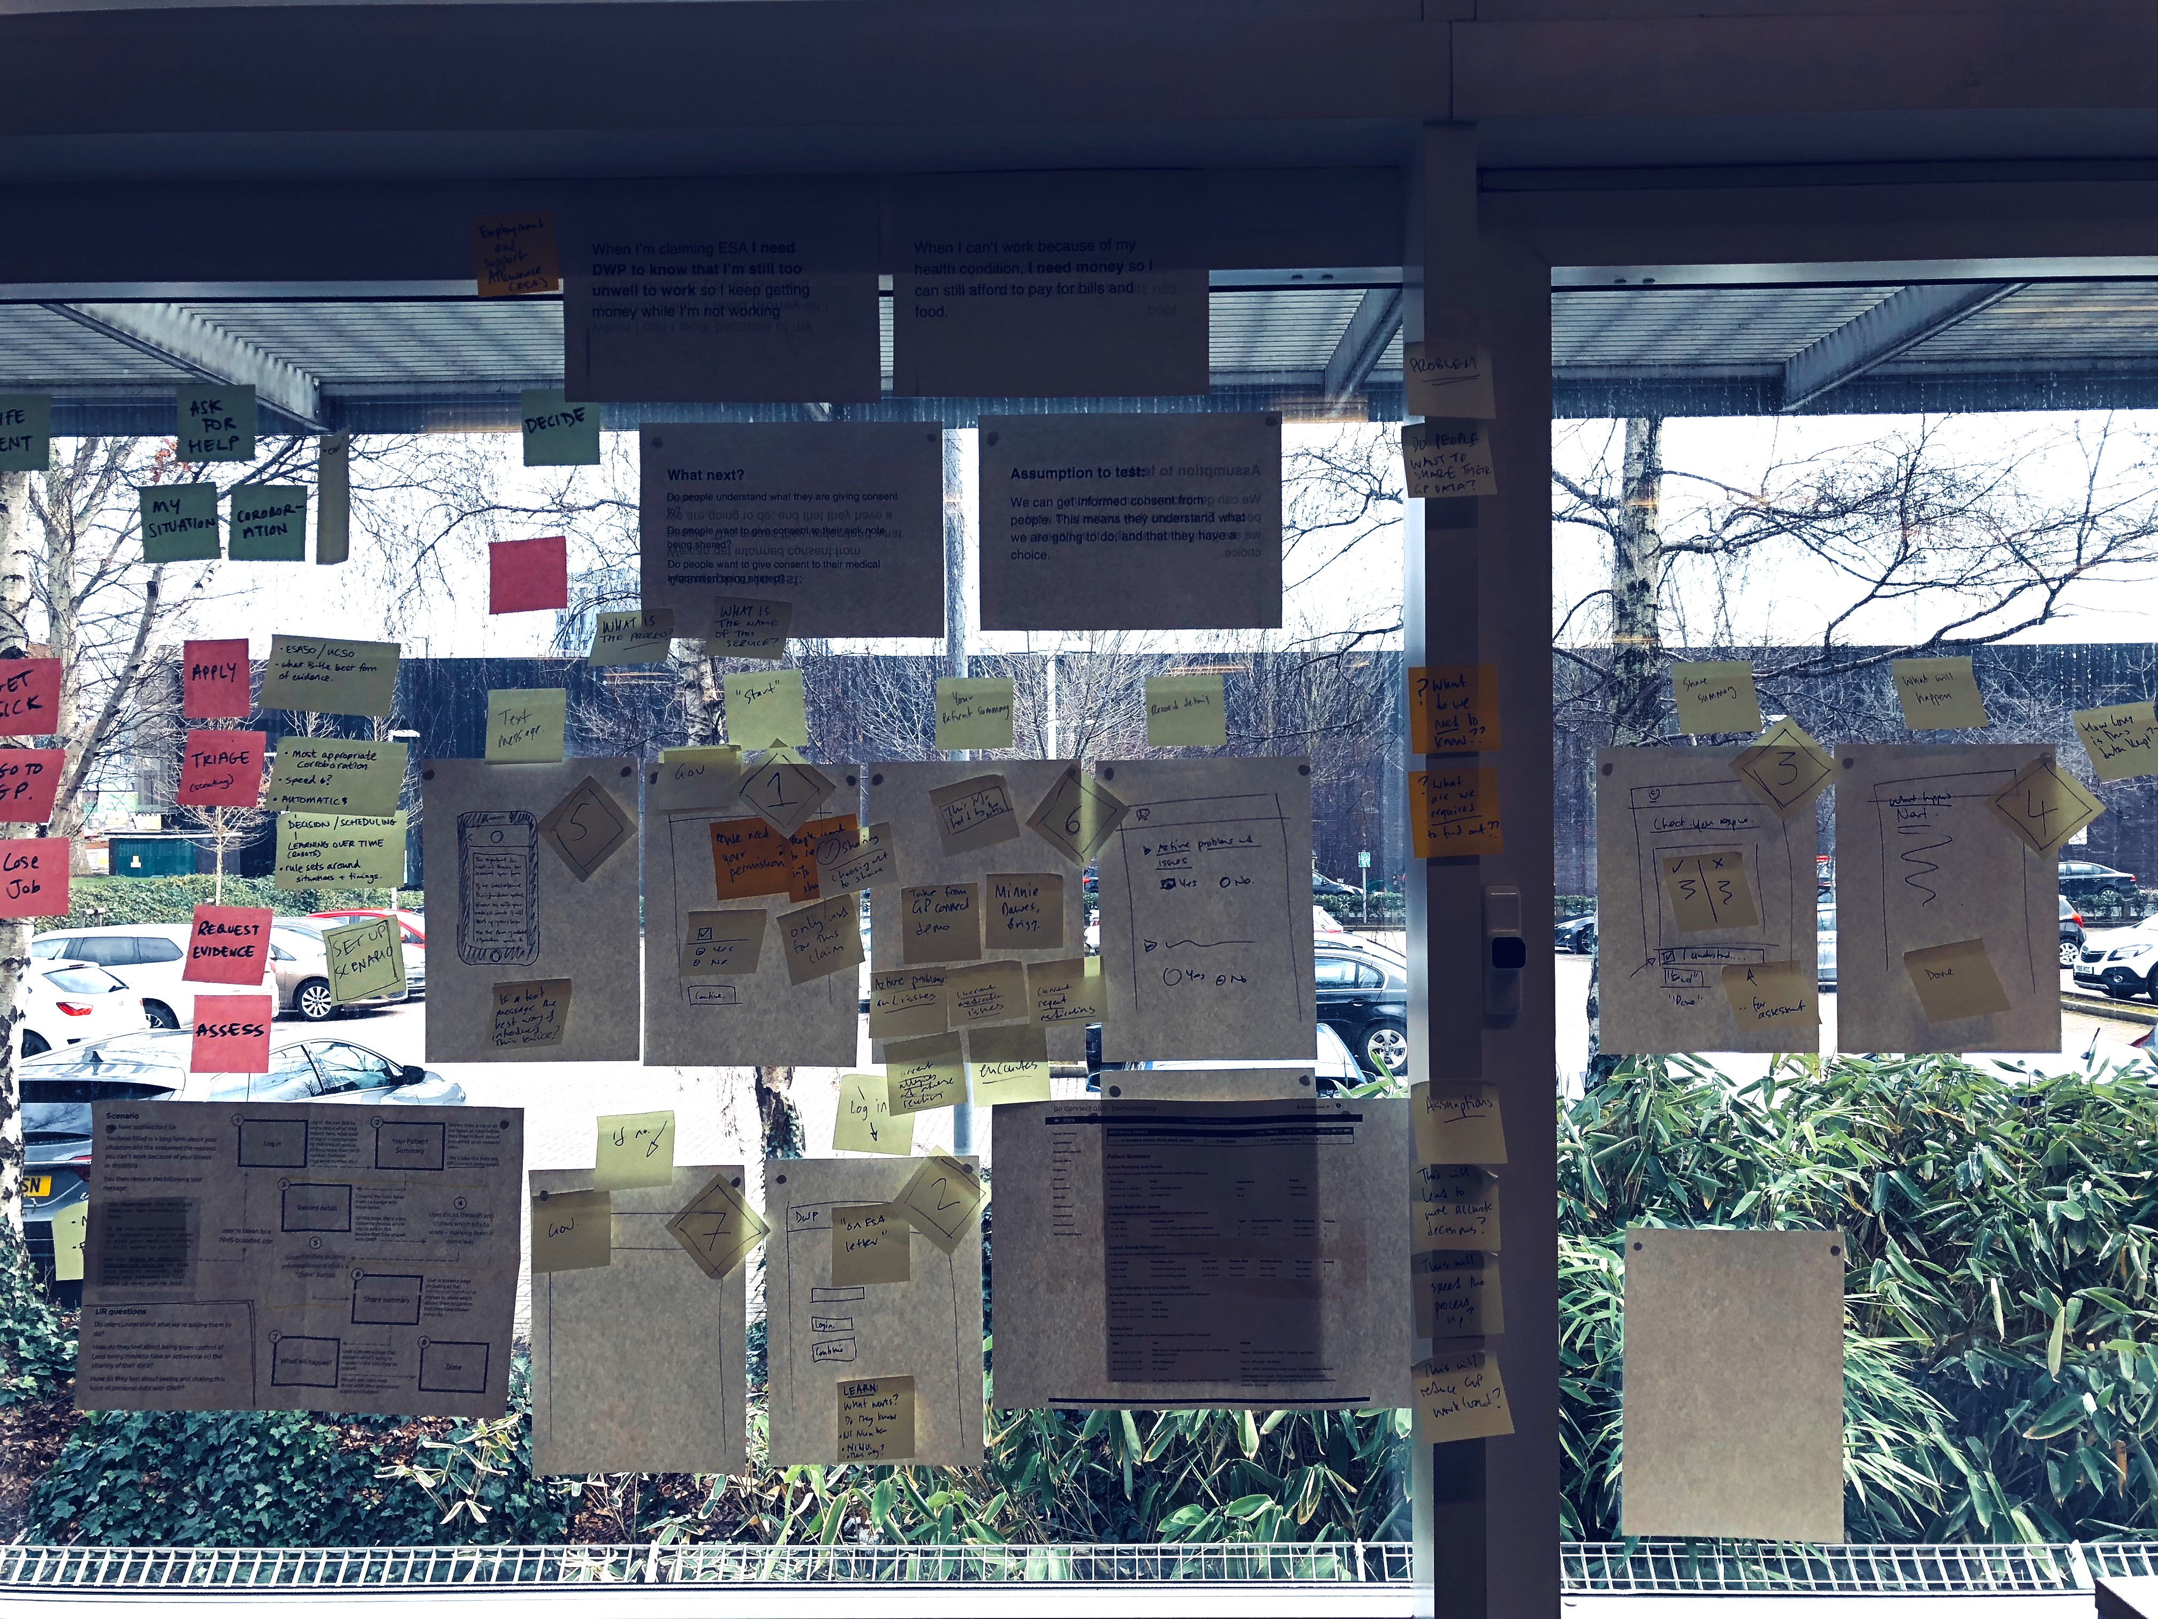
Notes:
Here’s an example of a prototype I did with the health team. I needed some “briefing time” to understand what they were doing, what they were wanting to do. We had an hour. We had to have it done in the next couple of days. And I was fitting it in around some other stuff.

Slide 52
Notes:
This is it in close up.
We had about four of us, so we agreed to paper prototype. You can see here a mix of approaches: straight sketches, Post Its.
We aimed to create a neater version of this by drawing it neater.
Once we were done, I realised I had a couple of hours the next day so we had a quick think and agreed - not coerced! - we’d have time to do something more high fidelity. We agreed it would just be a collection of static screens using the gov.uk prototype kit. Nothing clever-er. But it’d help us understand the problem. The user researcher felt it would be a good fit for the pop up session they were running.

Slide 53
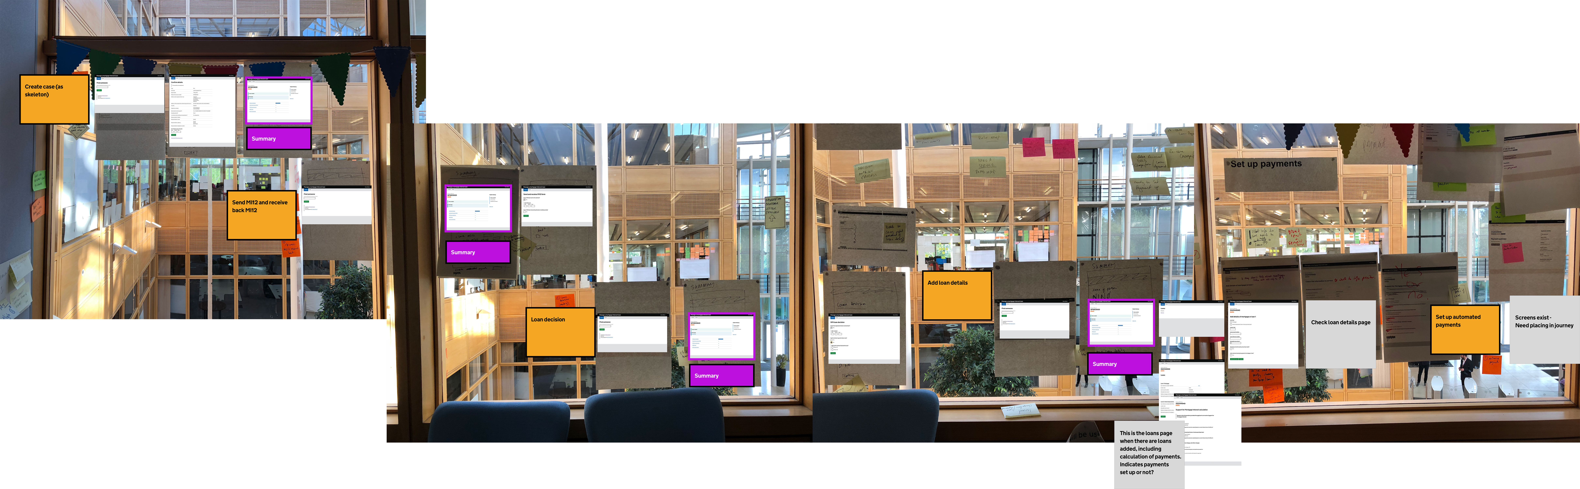
Notes:
Here’s something hot off the press! This is a product I am working on. On the window are the sketches. Overlaid are the screens as they are.
On the window you’ll see sketches which are lo fidelity, but there’s a high fidelity in the thinking. That journey covers those four windows. A week or so before that journey needed another wall. We’ve thought and redrawn this journey a few times, involving product owners, business analysts, devs, tech architects.
As I talk Em and Jo are in Seaham testing an in-browser version of this. Next week we’ll have created an in-browser version - which is the work in progress you can see here - to Seaham and Clydebank to learn more.
But there’s a process here.
Explore within the team. Understand and agree as a team your thinking to you design approach. Understand what works, what doesn’t work, what you are suggesting as a design solution, what you are showing is something to get a response.

Slide 54
Lots
Tight
Time
Little
Loose
Thinking

Slide 55
Learning by doing! (Not just talking.)
Notes:
If you gotta talk get something down. Grab some paper, some stickies, some pens. Even if it takes five minutes it’s five minutes to record an idea, something to refer to. Getting ideas down is in a safe space in your teams - no-one should feel left out. There is a lot in the psychology of getting something out of your head and down. The mind likes some sort of closure. It allows to get something out of your head and into a place where everyone can see it.

Slide 56
“Design is the method of putting form and content together.”
–Paul Rand
Notes:
Content can be sentences, statements, questions, objectives, goals. You don’t need to draw. Write! A service is a series of questions we need to get responses, answers to.

Slide 57
Learn by doing analysis!
Notes:
We talk about “doing research” and “designing” but I rarely hear people value this as an equal thing. It is! Value this! It’s where your insights, your next actions come from!

Slide 58
Designing is a process.
Notes:
Designing is a process. And the outcome of the accumulative efforts of many people, in, around, and outside of the product team. Product owners are the design chiefs, the judge.

Slide 59
Understanding
Define
Ideate
Prototype
Test
Production
Do research to discover who users are what they do, say, think and feel.
Combine research and analyse to understand users and their needs.
Focused on the needs, as a team explore possible ideas. Quantity over quality.
Build tactile representations of your ideas. Consider impact versus feasibility.
Put the work in front of users. Find what works and doesn’t work.
Notes:
This is a cycle, not a flow. We can go back at any point. And when it’s good enough - the product owner’s call - it moves onto production.

Slide 60
No more black boxes!
Notes:
Be open! Be clear!

Slide 61
Work together! Work as one!
Notes:
As a product owner you can help the team work towards one goal. You can set the mood of the team, the flow of the team. You’re a coach!

Slide 62
Continual gradual improvement.
Notes:
…and be mindful of progression. Every few days, every sprint, clearly indicate how the team has moved forward, in they thinking, in their outcomes, in what they are making.

Slide 63
Start with the needs*.
Notes:
And always this.
On which note: Is there anything we can do to help you?

Slide 64
Thank you.
Feel free to get in touch
Email: simoncwilson@gmail.com
Twitter: @ErmLikeYeah

